Slide 1
Modelling Smart FPGA Switches in the Network
Benji Levine
Supervised by Suhaib Fahmy

Slide 2
What are FPGAs?
Field-Programmable Gate Array
Flexible Logic ---------------------------------
Flexible routing -------------------------------
Flexible IO ------------------------------------
Embedded hard modules --------------------
LUTs
Large grid of wires and switch boxes
Support for 10G Ethernet, SATA, PCIe
Block memory, DSP blocks
Notes:
Flexible logic: basic configurable block to implement combinational logic, coupled with clocked elements to enable synchronous logic and pipelining
Flexible routing: significant chip area dedicated to wires and switch boxes that enable connections between all components
Flexible IO: multi-standard interfacing to external pins, with a range of speed capabilities
Embedded hard modules: an increasing number of different resources optimised for speed and area, including DSP functions and memories

Slide 3
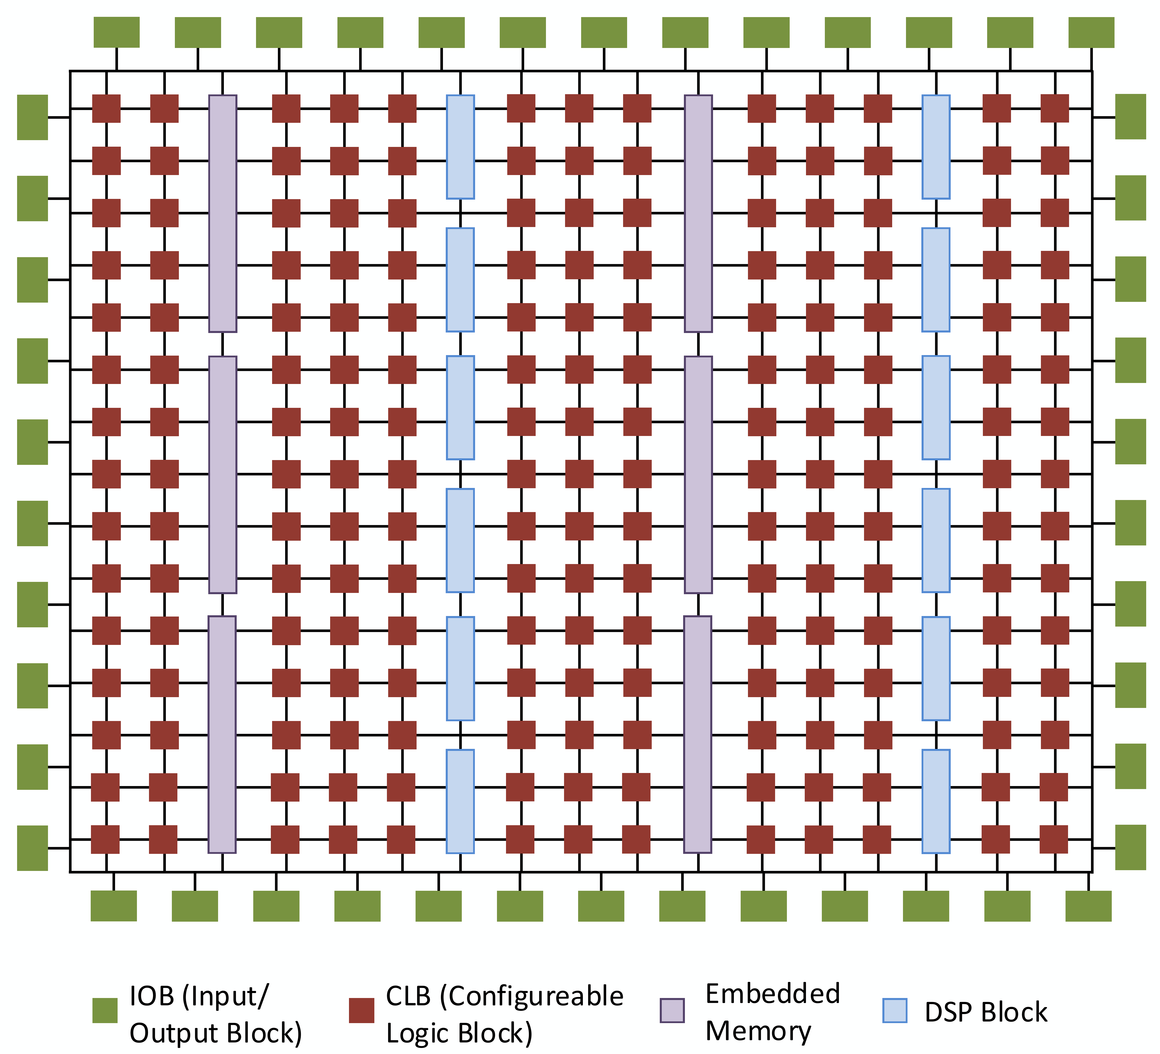
What are FPGAs?
Field-Programmable Gate Array
Flexible Logic
Flexible routing
Flexible IO
Embedded hard modules
Notes:
Flexible logic: basic configurable block to implement combinational logic, coupled with clocked elements to enable synchronous logic and pipelining
Flexible routing: significant chip area dedicated to wires and switch boxes that enable connections between all components
Flexible IO: multi-standard interfacing to external pins, with a range of speed capabilities
Embedded hard modules: an increasing number of different resources optimised for speed and area, including DSP functions and memories

Slide 4
Networking Concepts
OSI Network Model
TCP / IP network stack
Application
Presentation
Session
Transport
Internet
Network
Data Link
Link
Physical

Slide 5
Networking Concepts
Control plane
Data plane
P4
OpenFlow (part of Mininet)
OSI Network Model
TCP / IP network stack
Application
Transport
Internet
Link
Software Defined Networking
Notes:
SDN separates the control plane from the data plane
Gives the programmer more direct and clear control over how routing decisions are made.
Separates the network control, known as the control plane, from the forwarding process, known as the data plane.
The control plane makes decisions about packets which are either destined to or originally from the current host, while the data plane makes decisions about packets which are going through the host.
The control plane also maintains the routing table, which is used by both planes to make routing decisions
P4 is a language for programming data plane. Sep 2014.

Slide 6
Why Smart FPGA Switches?
Cloud computing
High latencies
Large data centres
Amazon Web Services (AWS)
Microsoft Azure
Google Cloud Platform
Apache Hadoop

Slide 7
Why Smart FPGA Switches?
Cloud computing
Existing solutions
“Edge” / “gateway” nodes
Mainframes
NetFPGA
Software Defined Networking (SDN)

Slide 8
Why Smart FPGA Switches?
Cloud computing
Existing solutions
Drawbacks
Similar to data centres
Latency
Security
Scalability

Slide 9
Why Smart FPGA Switches?
Cloud computing
Existing solutions
Drawbacks
Solution
Do not divert data from existing path
Appropriate device for computation
Static
Flexible
Fast
Slow
ASIC
FPGA
CPU

Slide 10
Why Smart FPGA Switches?
Cloud computing
Existing solutions
Drawbacks
Solution
FPGAs
Custom compute architectures – very low latency
Partial reconfiguration
Specific hardware for each algorithm

Slide 11
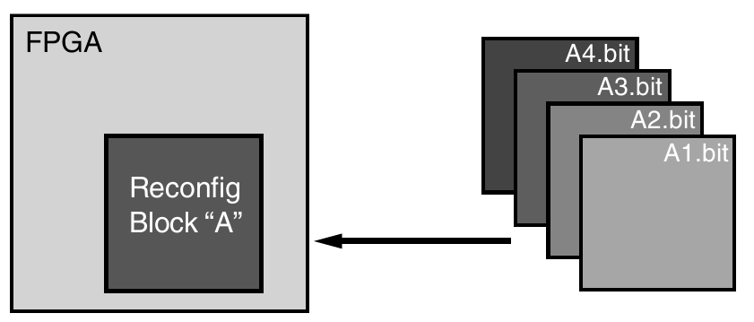
Why Smart FPGA Switches?
Cloud computing
Existing solutions
Drawbacks
Solution
FPGAs
Partial reconfiguration
Specific hardware for each algorithm

Slide 12
Research and Implementation
Mininet
“Emulator for rapid prototyping of Software Defined Networks”
Open source
Python API
Scalable
Dependency chain

Slide 13
Research and Implementation
Mininet
NetFPGA
PCI Express interface
Xilinx Virtex / Kintex
4 x 1Gbps – 10Gbps Ethernet
Open source software
1G, 10G, SUME, CML
Standalone or integrated

Slide 14
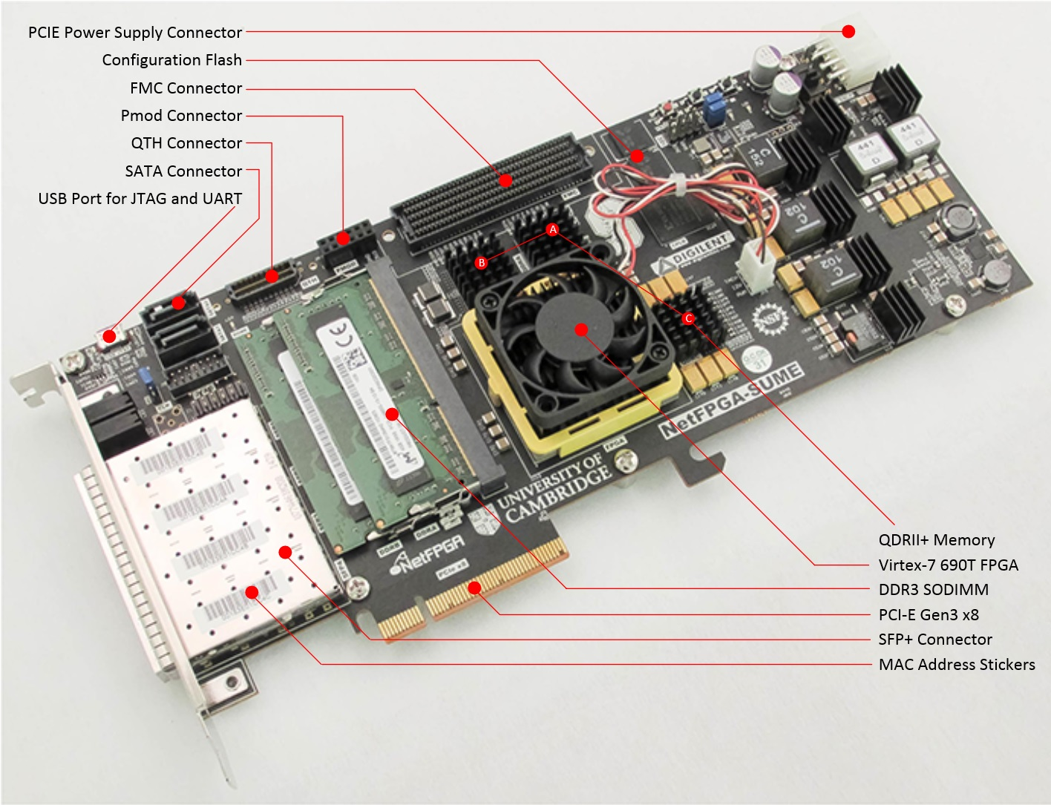
Research and Implementation
Mininet
NetFPGA
PCI Express interface
Xilinx Virtex / Kintex
4 x 1Gbps – 10Gbps Ethernet
Open source software
1G, 10G, SUME, CML
Notes:
Just under 8GB/s
7.875GB/s

Slide 15
Research and Implementation
Mininet
NetFPGA
PCI Express interface
Xilinx Virtex / Kintex
4 x 1Gbps – 10Gbps Ethernet
Open source software
1G, 10G, SUME, CML
Standalone or integrated

Slide 16
Research and Implementation
Mininet
NetFPGA
Software Development
Python
Open source (GitHub)
setuptools
click
logging
git submodules

Slide 17
Project Management
Agile methodology ---------------------------
Kanban Board --------------------------------
Version control --------------------------------
Weekly meetings with supervisor ----------
Issues resolved quickly -----------------------
Adaptive to change
Trello
git
Comparable to “scrums”
Access to tools, licensing

Slide 18
Model Results
Get a graph

Slide 19
Applications
Internet of Things (IoT)
Education
Military
Education

Slide 20
Demo

